Slide 1
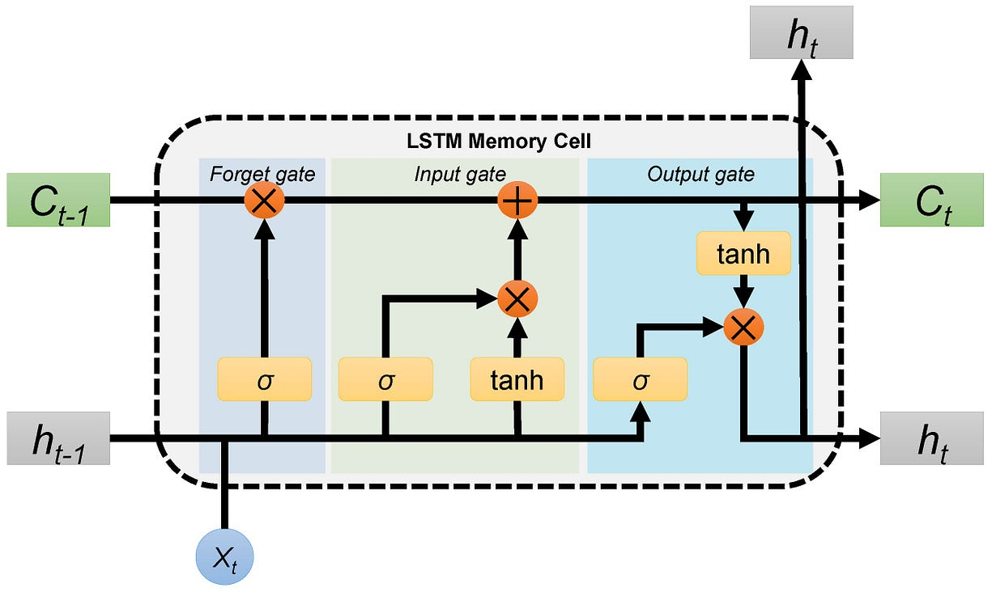
Long Term Memory
New long-term memory
What percentage of the long-term memory to remember
Potential short-term memory
What percentage of the potential memory to remember
Potential long-term memory (input+short)
What percentage of the short-term memory to remember
Short Term Memory
New short term memry

Slide 2
Predict the number of passenger next month
Data set airline passengers :
Load and visualize the dataset.
Preprocess + normalize data.
Prepare sequences for supervised learning.
Build a stacked LSTM model.
Train and evaluate.
Plot training history and forecast results.

Slide 3
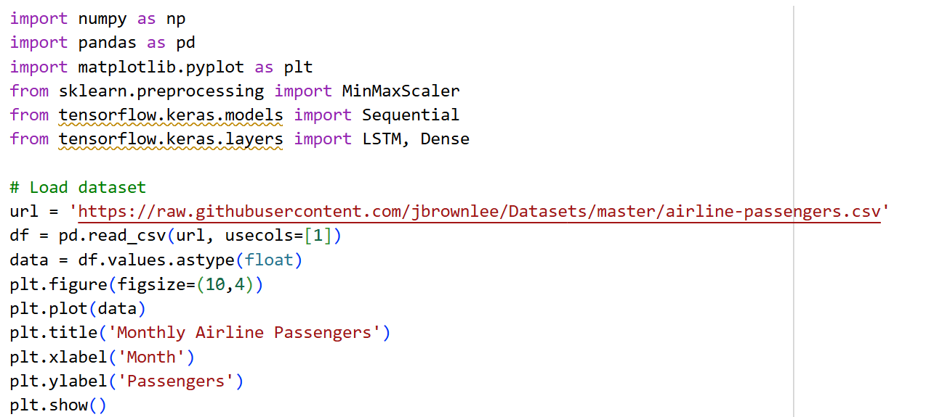

Slide 4
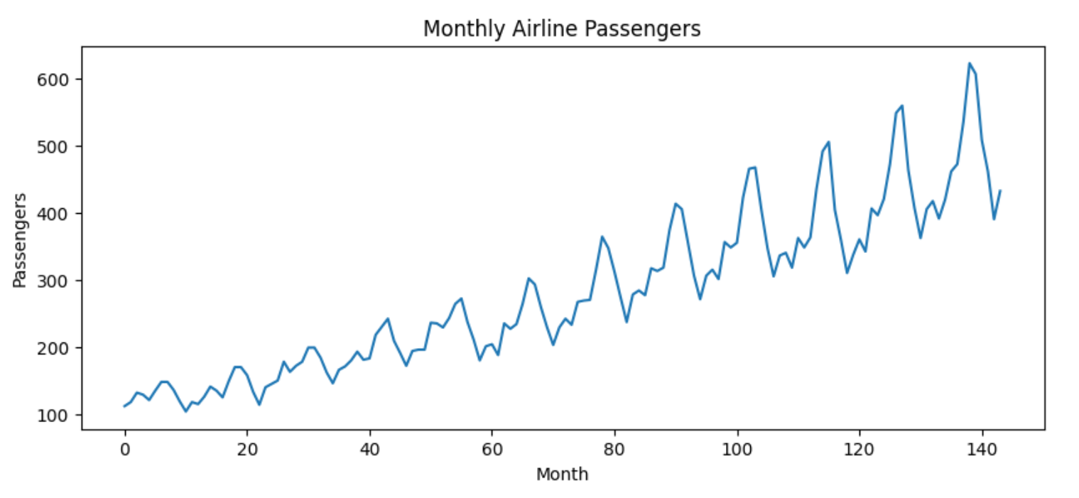

Slide 5
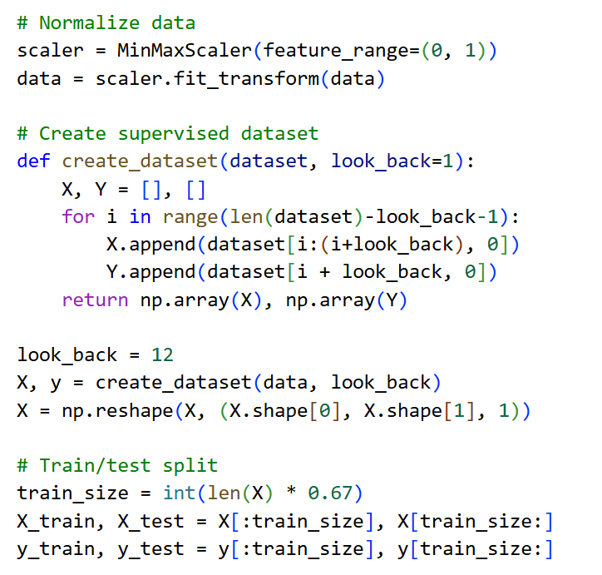

Slide 6
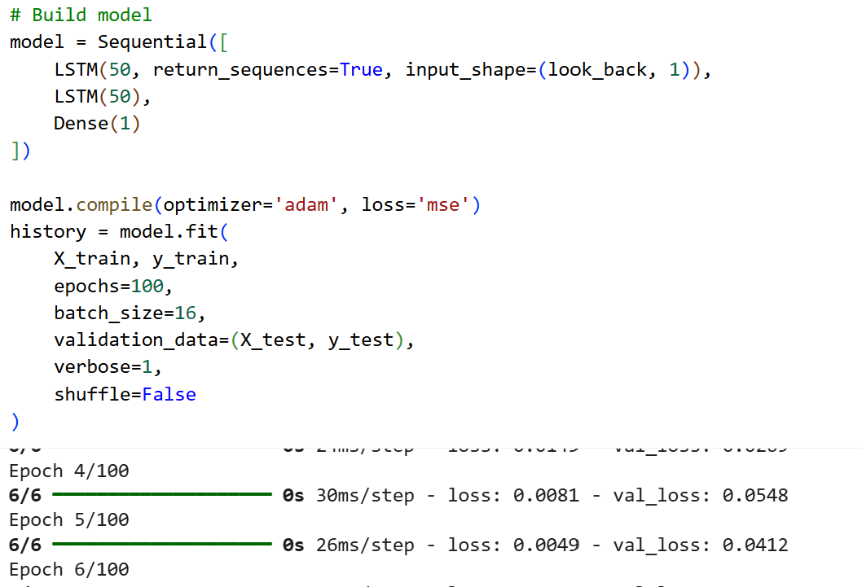

Slide 7
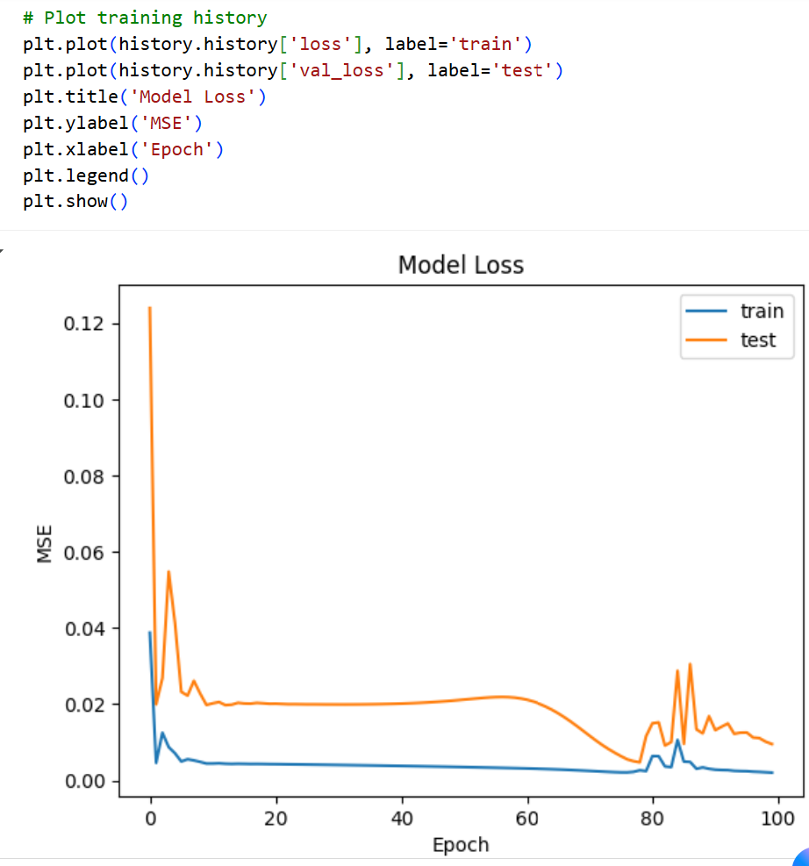

Slide 8
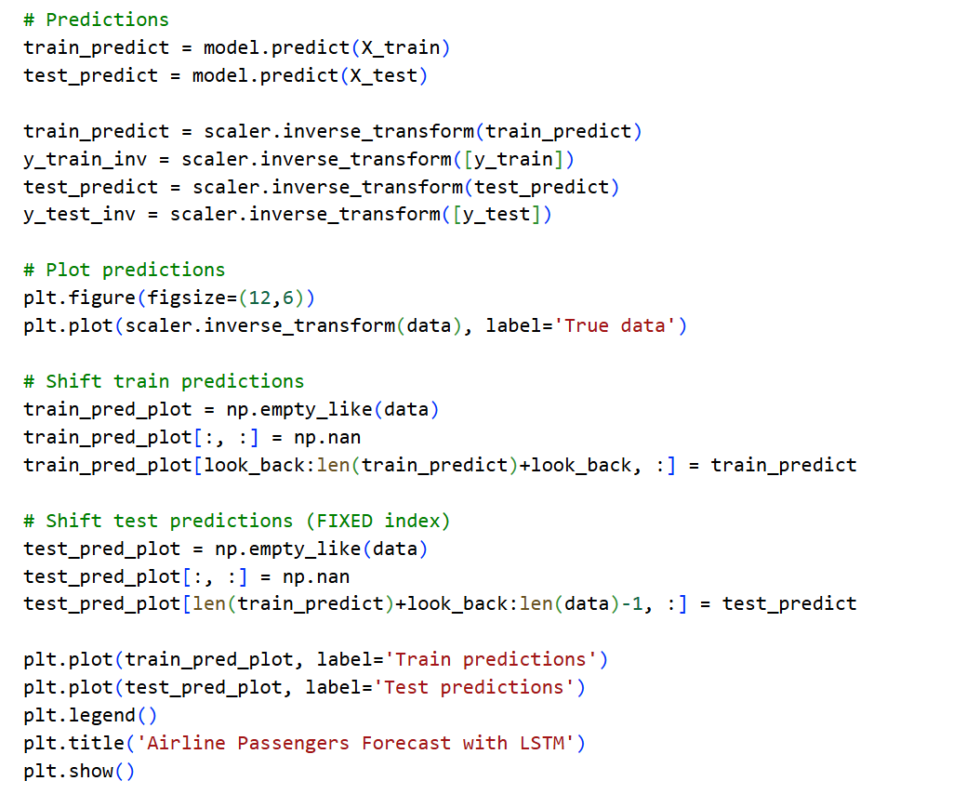

Slide 9
